Slide 1
Introduction
Sungjoon Choi
(sungjoon.choi@cpslab.snu.ac.kr)

Slide 2

Deep learning
RNN / LSTM
CNN
MLP
RBM

Slide 3
To tell the truth

Slide 4
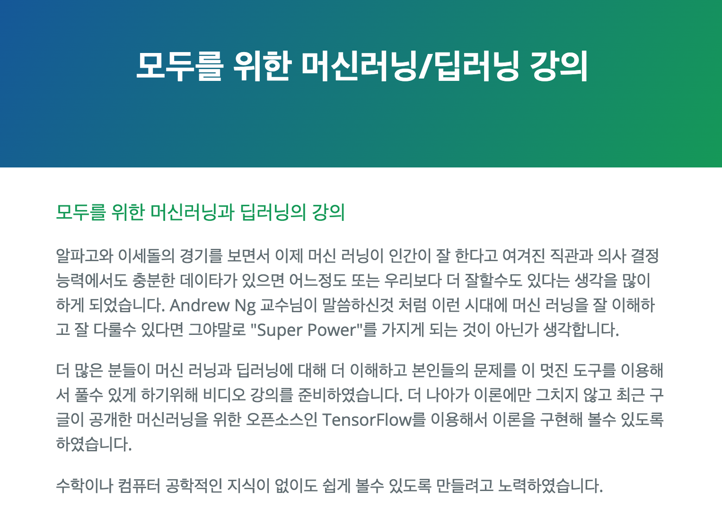
Deep learning tutorial
http://hunkim.github.io/ml/

Slide 5
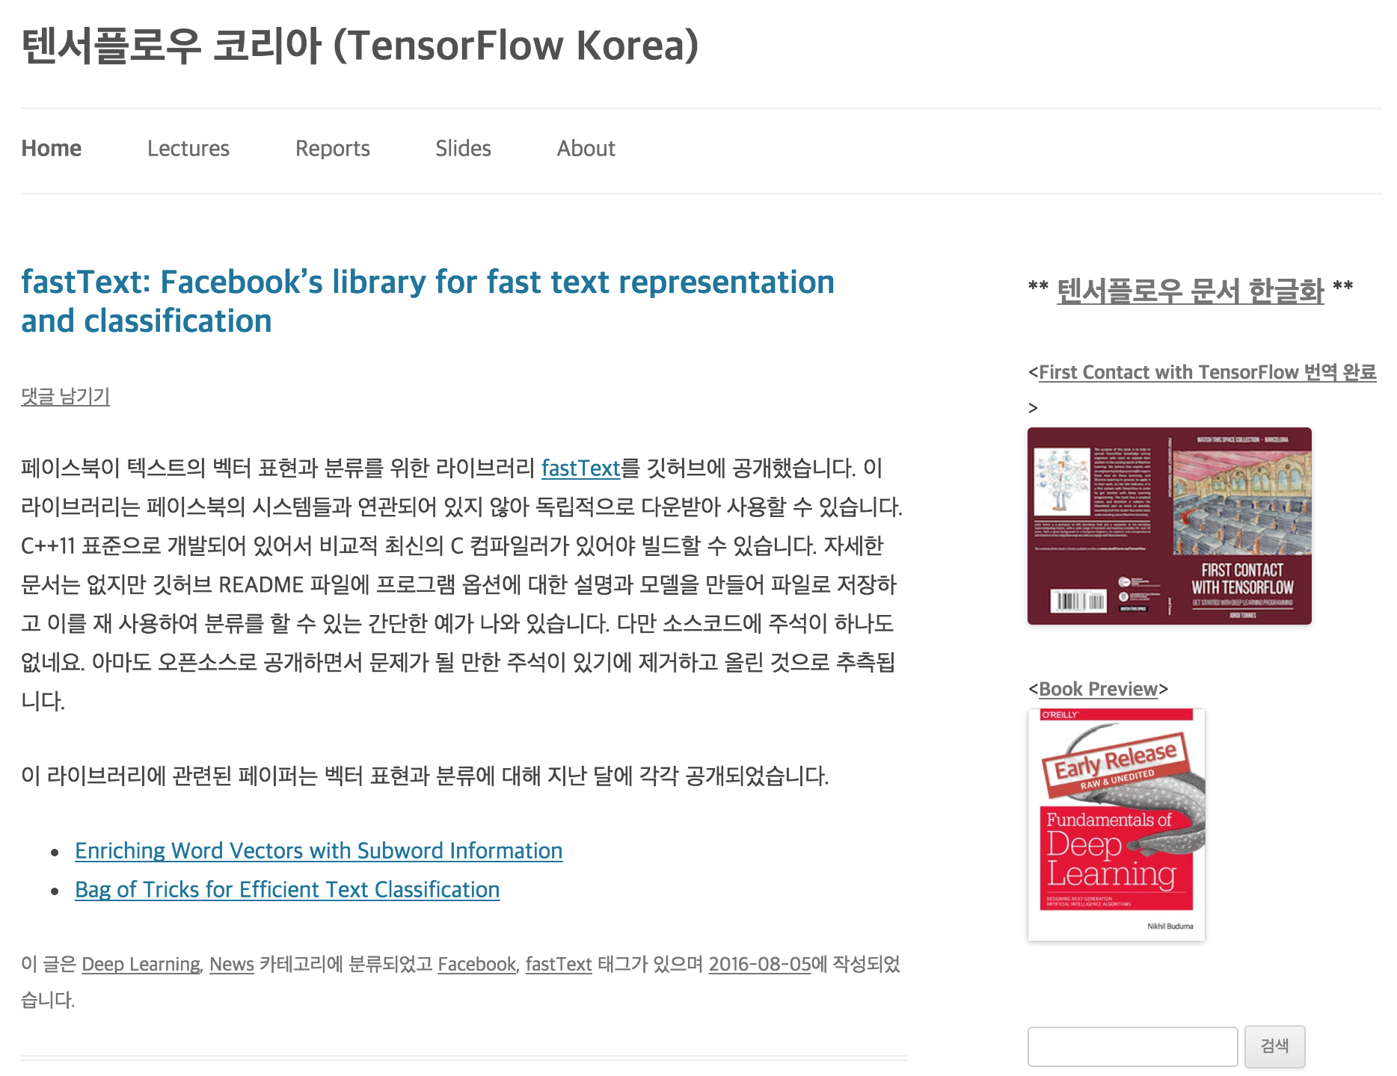
Deep learning tutorial
https://tensorflowkorea.wordpress.com

Slide 6
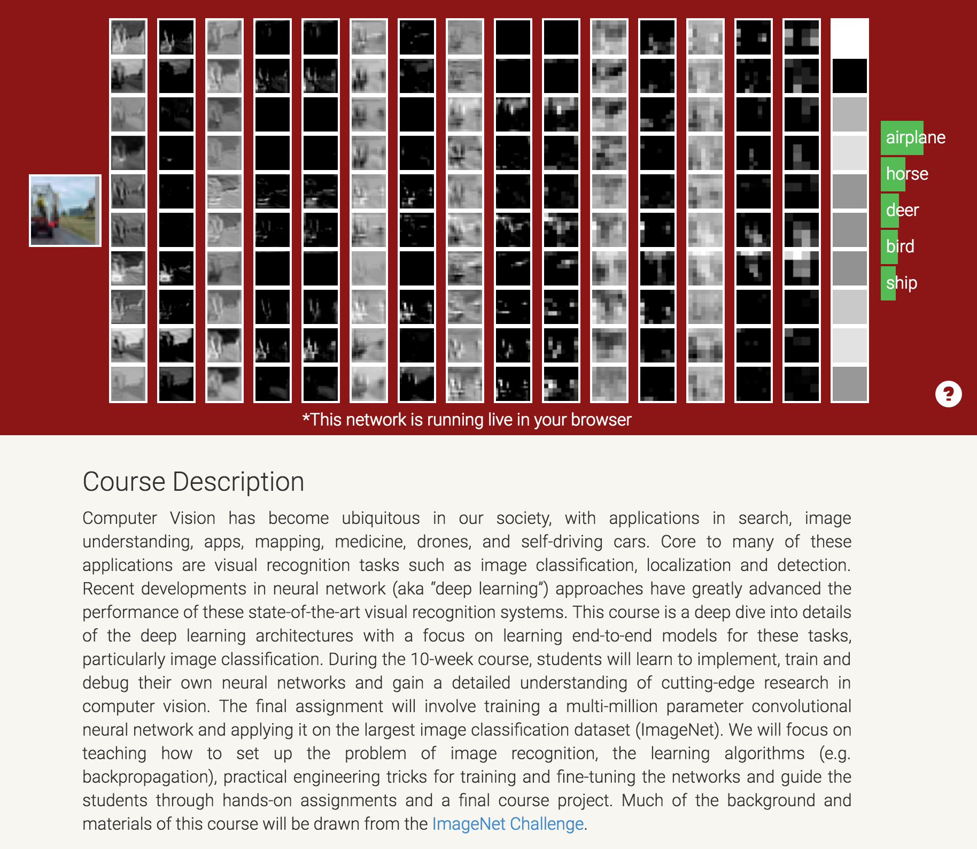
Deep learning tutorial
http://cs231n.stanford.edu/

Slide 7
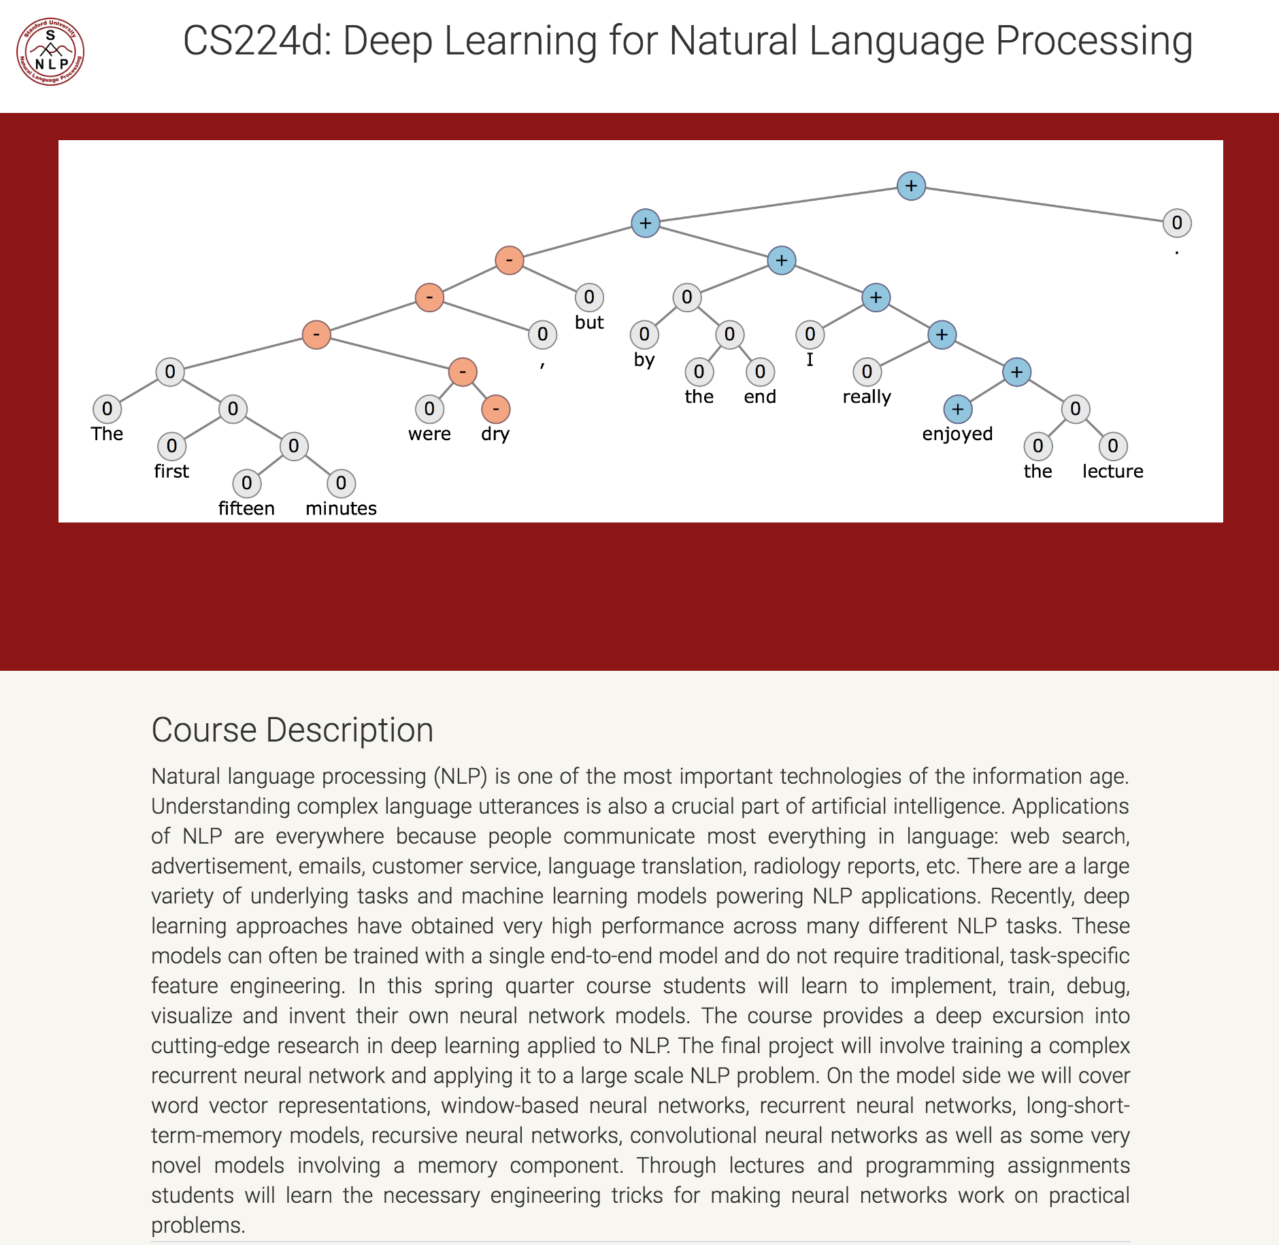
Deep learning tutorial
http://cs224d.stanford.edu/

Slide 8
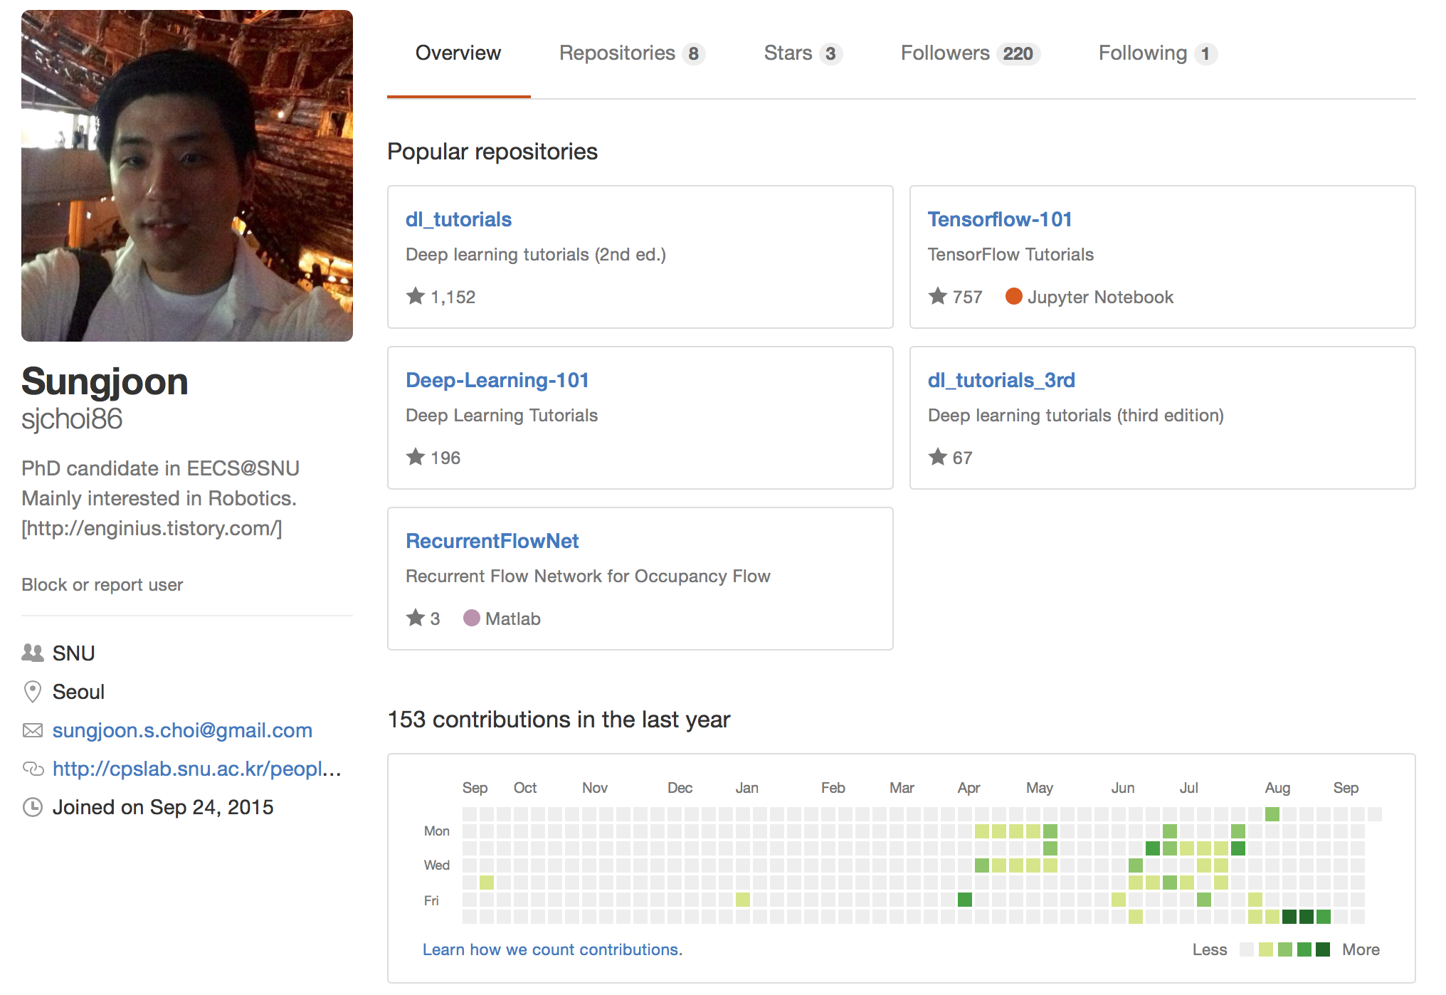
Deep learning tutorial
https://github.com/sjchoi86

Slide 9
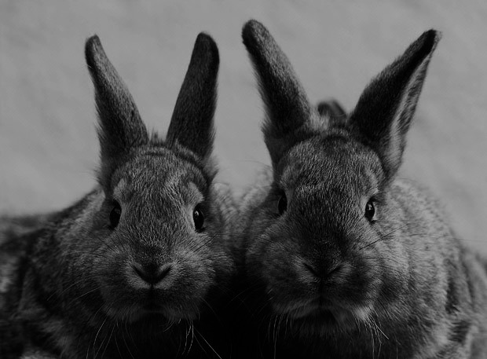
Goal
Deep Learning
Theories
TensorFlow
Implementation

Slide 10





SNS
?

Slide 11
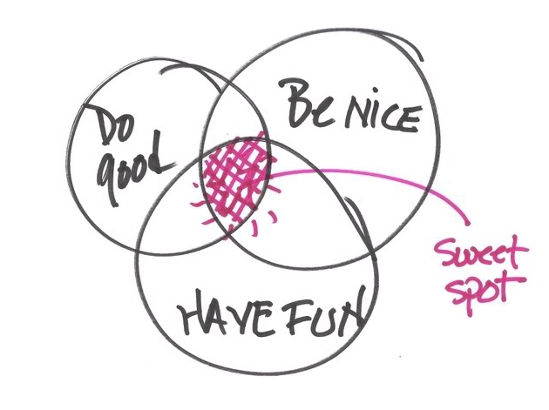
Importantly,

Slide 12

More importantly,

Slide 13
Deep learning theories covers, (in my original course)

Slide 14
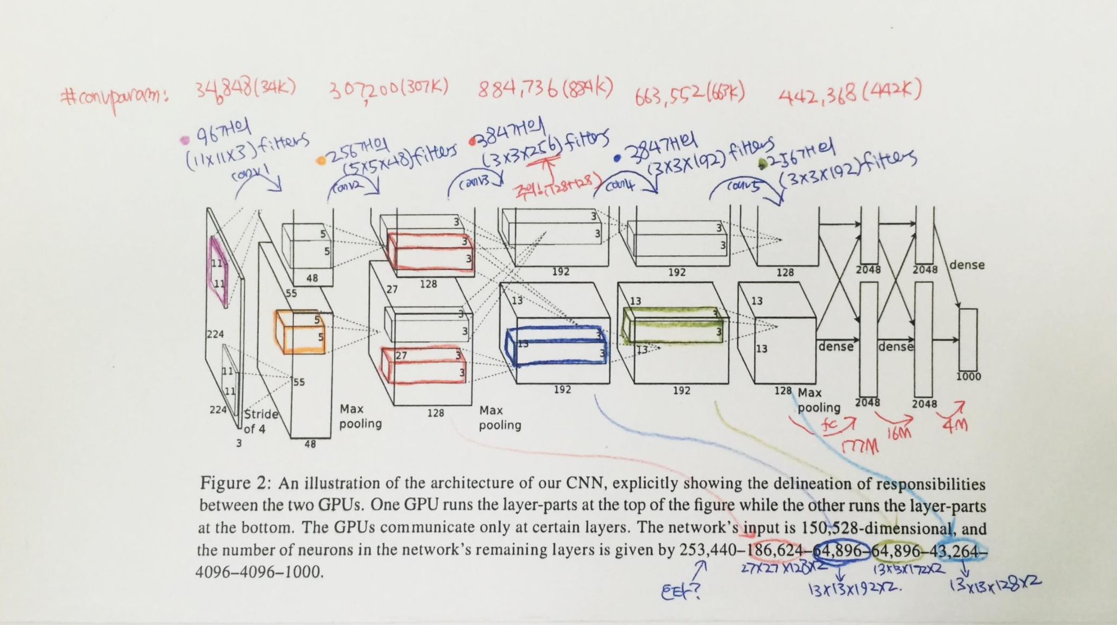
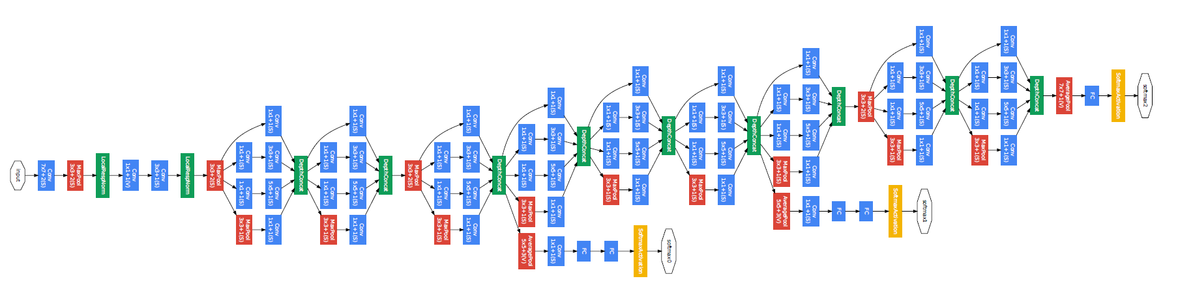
Convolutional neural network
AlexNet
GoogleLeNet

Slide 15
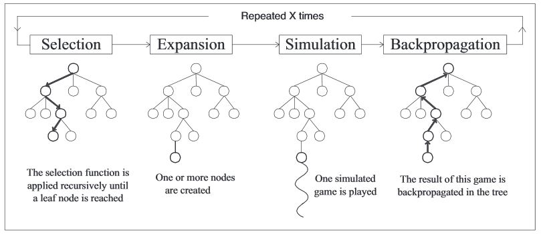
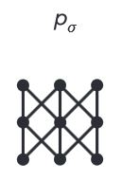
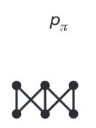
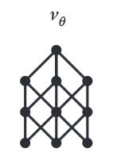
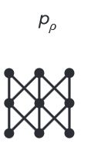
Algorithms behind AlphaGo
Rollout net
Value net
RL net
SL Policy Network

Slide 16

Regularization
Main purpose is to avoid “OverFitting”

Slide 17


Optimization methods

Slide 18
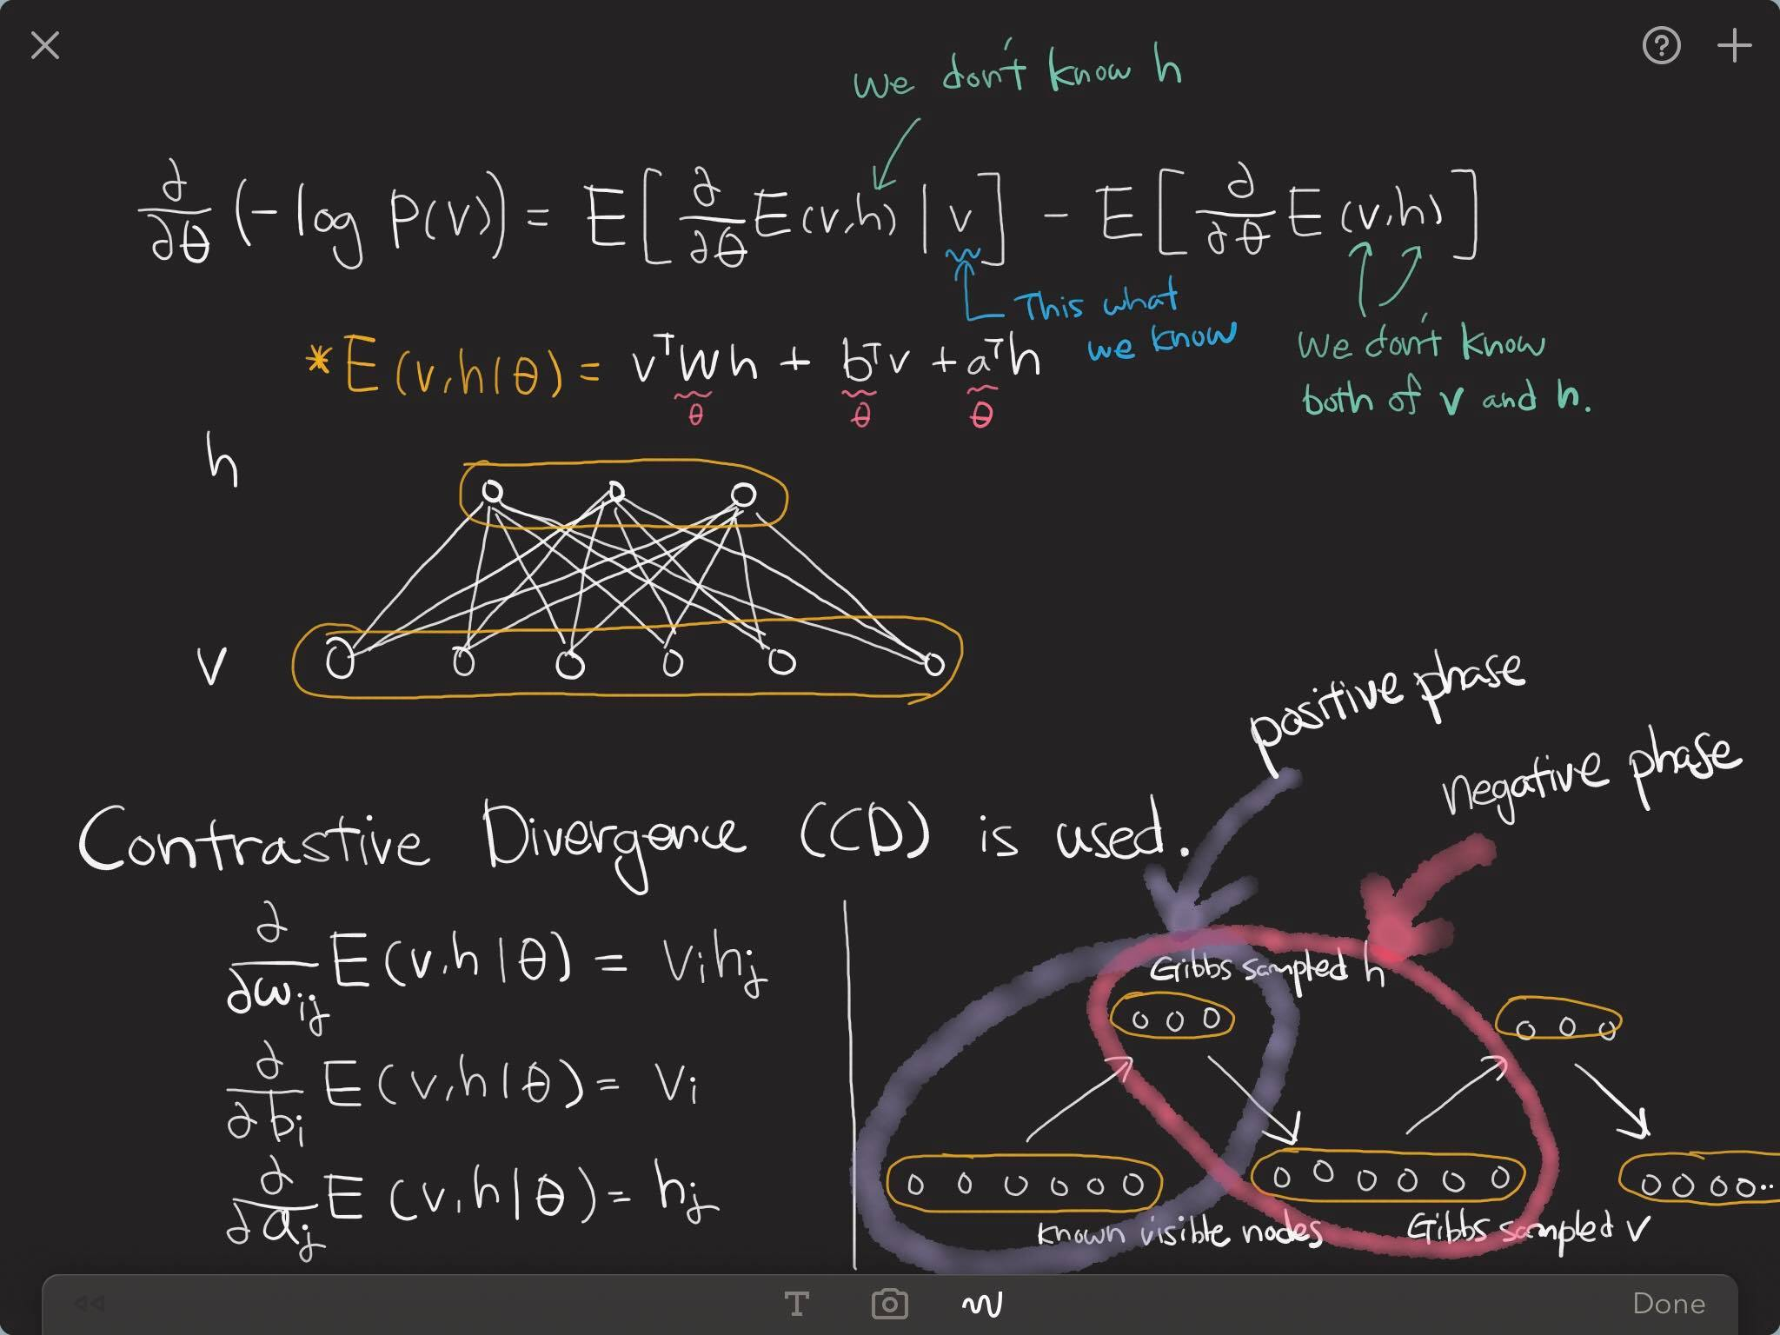
Restricted Boltzmann machine

Slide 19
Denoising auto-encoder

Slide 20
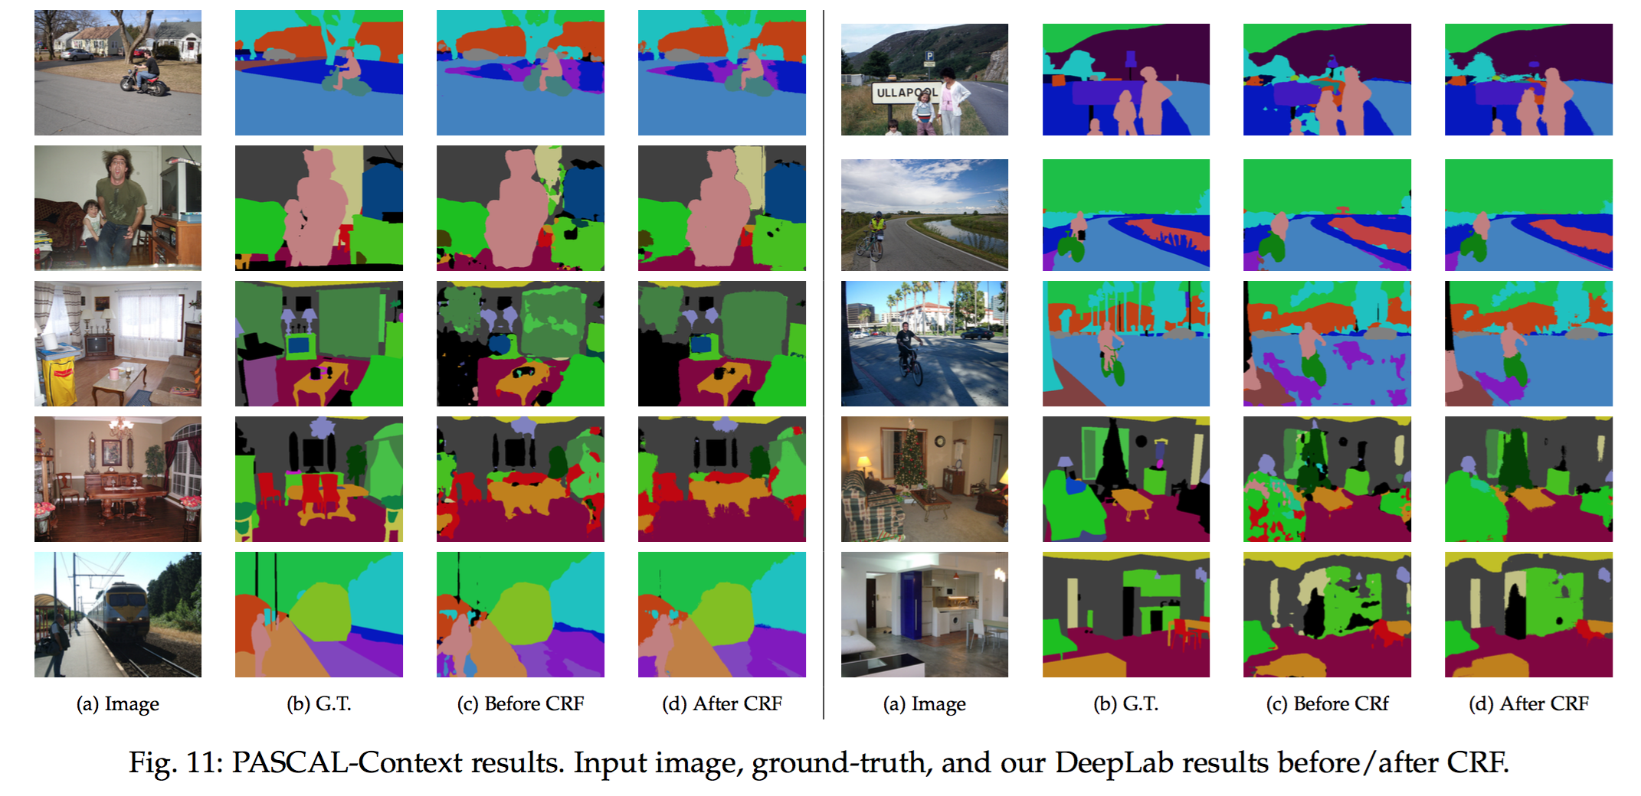
Semantic segmentation

Slide 21
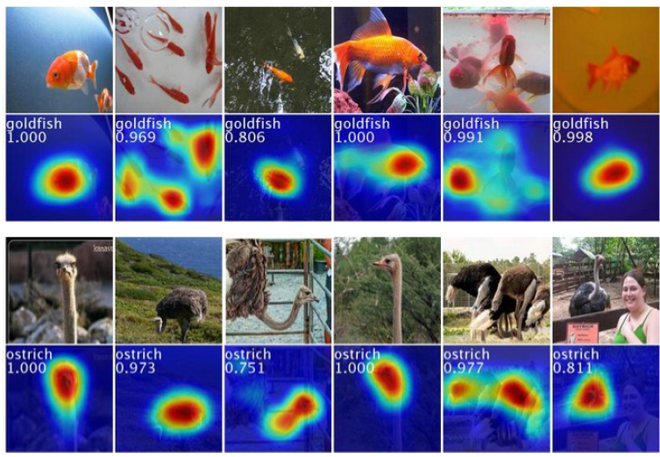
Weakly-supervised localization

Slide 22
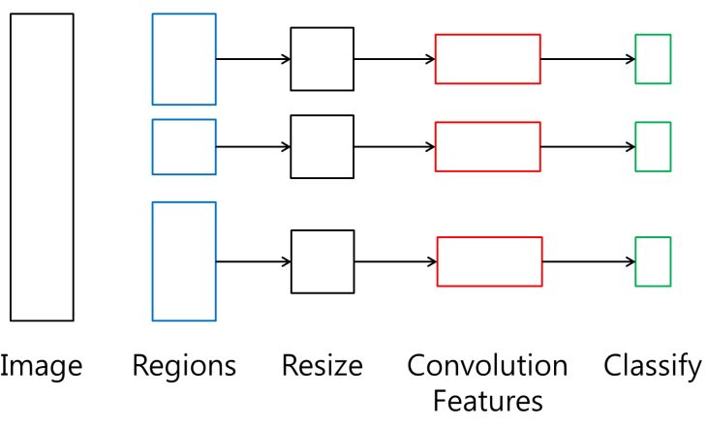
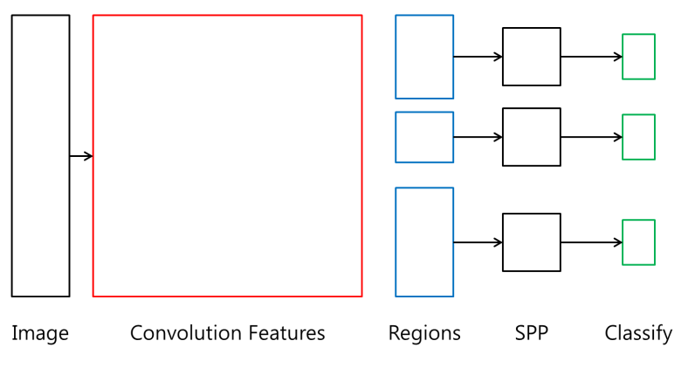
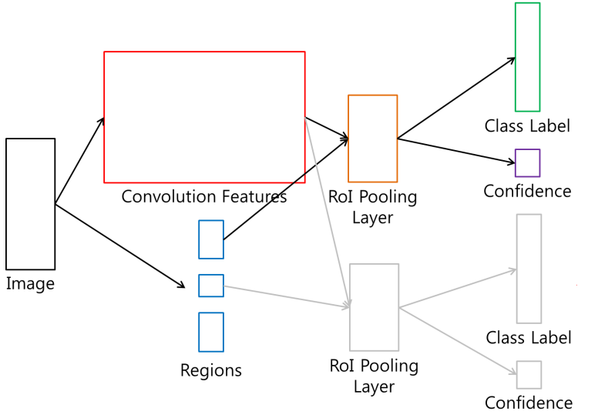
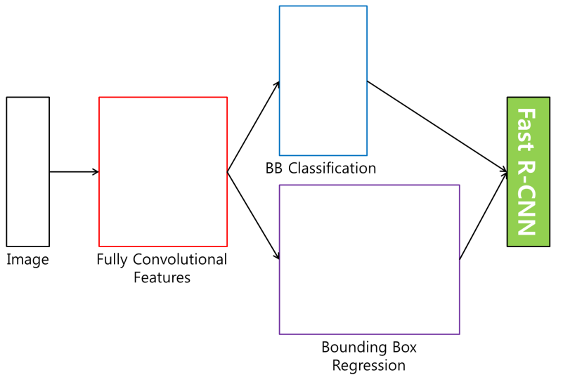
Object Detection
R-CNN
SPP net
Fast R-CNN
Faster R-CNN

Slide 23
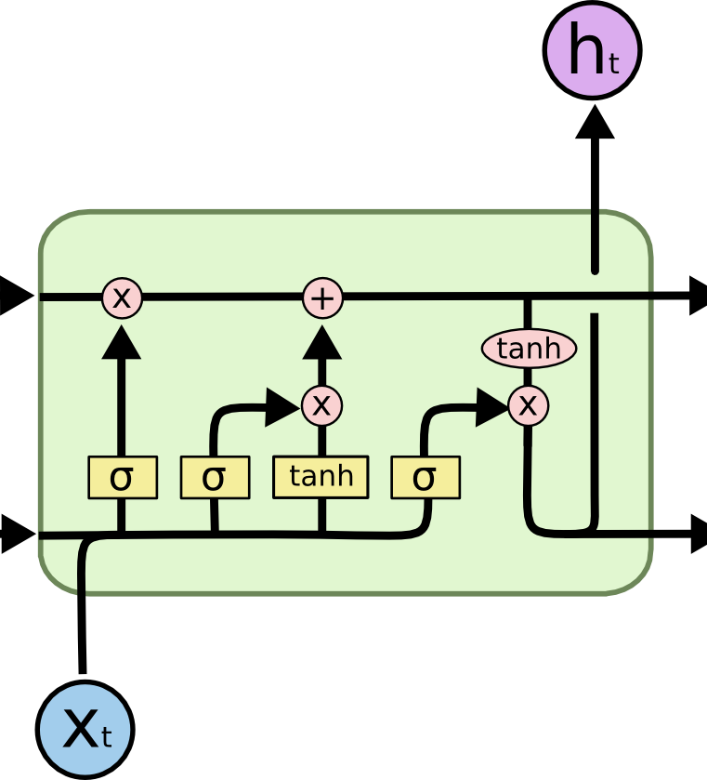
RNN - LSTM
Output
Forget Gate
(Cell) state
Next (Cell) State
Input Gate
Output Gate
Hidden State
Next Hidden State
Input
Output = Hidden state
23
http://colah.github.io/posts/2015-08-Understanding-LSTMs/

Slide 24
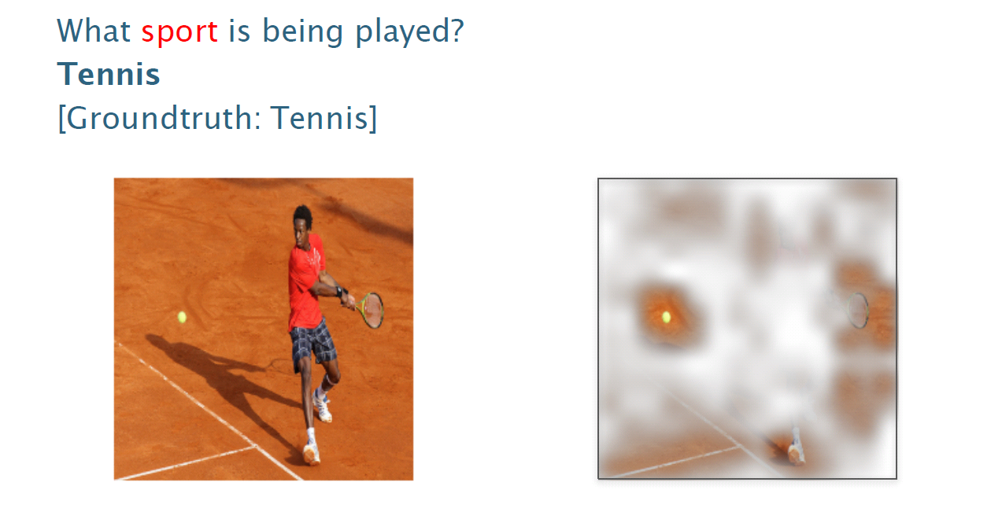
Visual Q&A

Slide 25
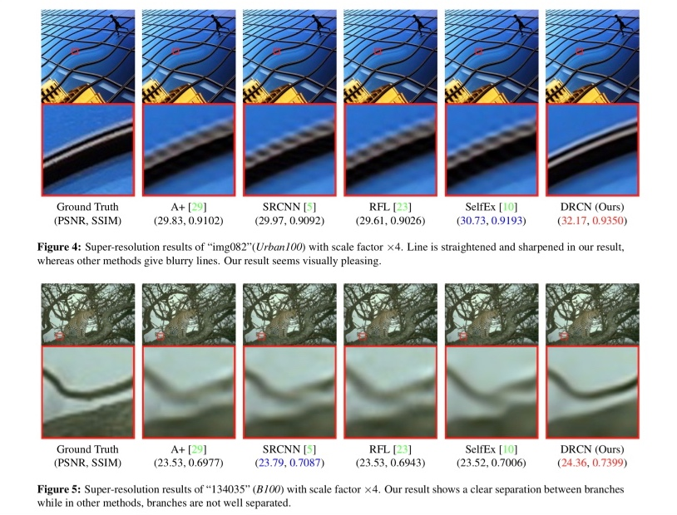
Super resolution

Slide 26
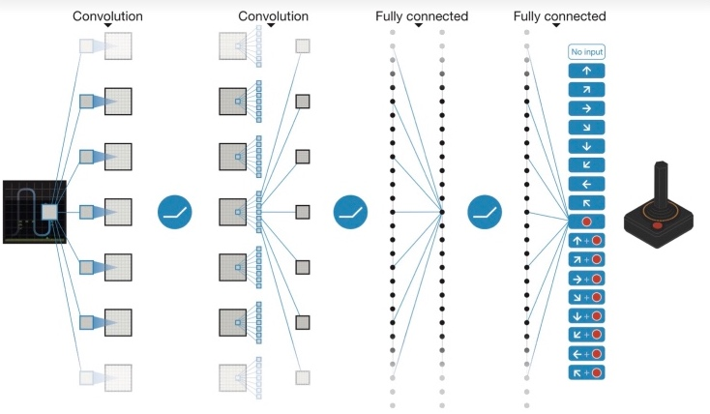
Deep reinforcement learning

Slide 27
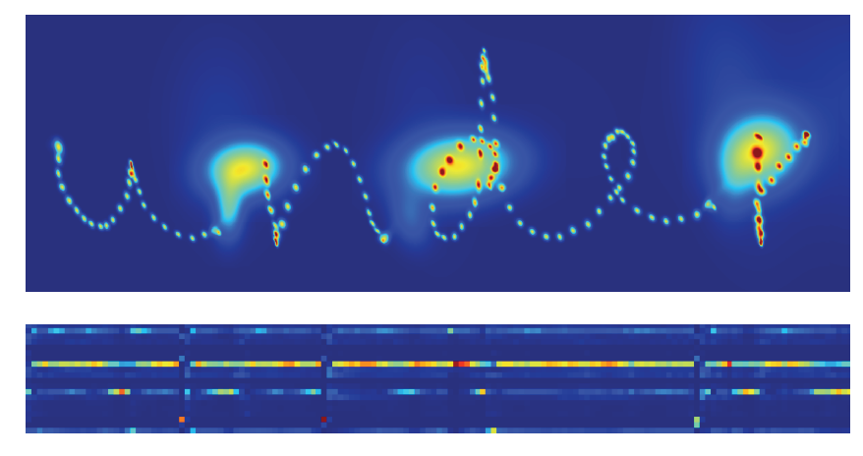
Handwriting generation

Slide 28
Word embedding

Slide 29
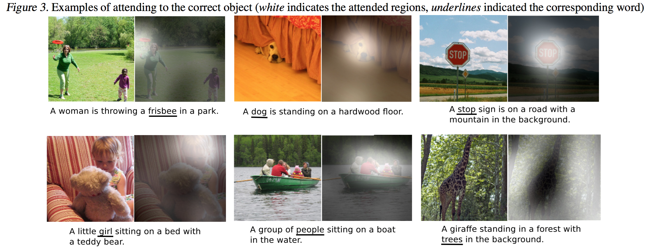
Image captioning

Slide 30
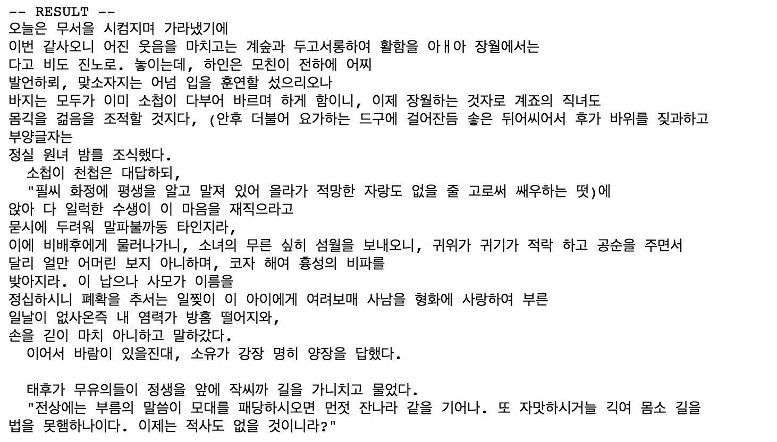
Hangul-RNN

Slide 31
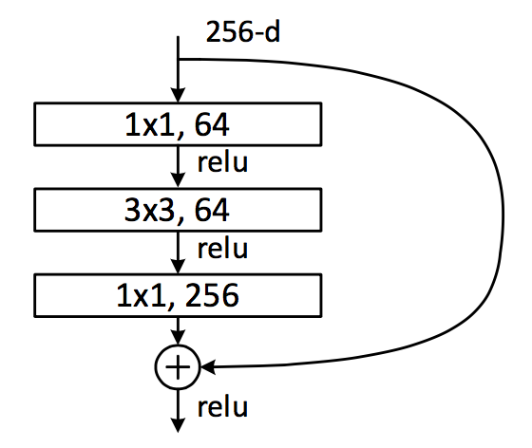
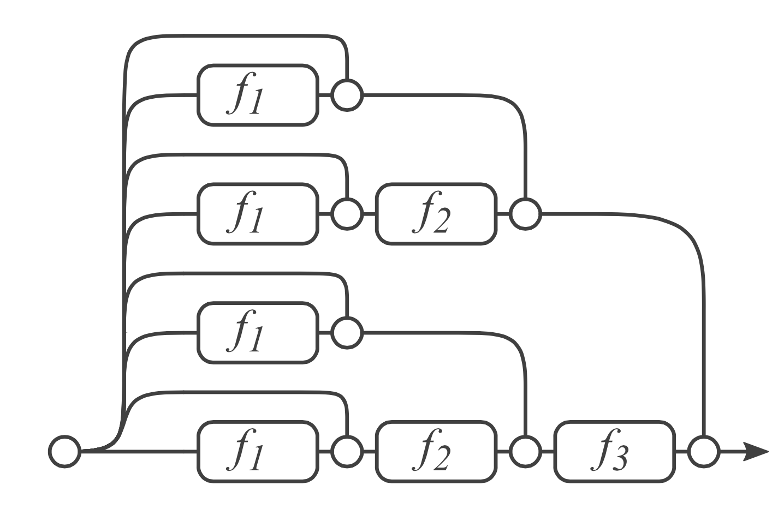
Residual Network & analyses
Dimension reduction
Convolution
Dimension increasement

Slide 32
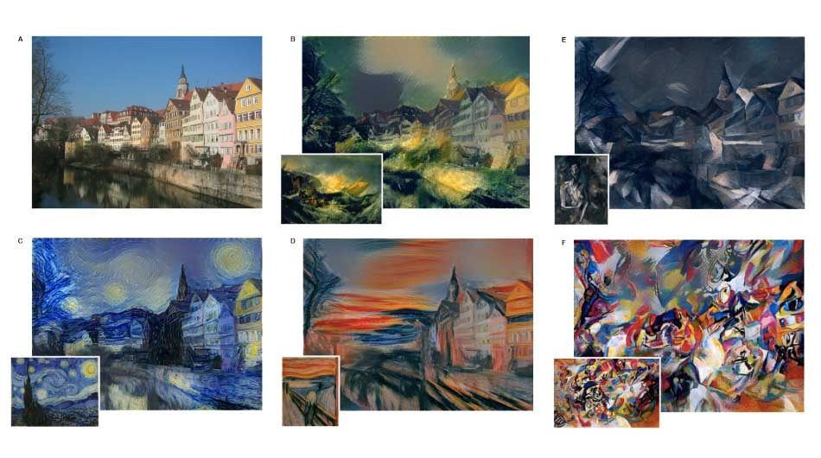
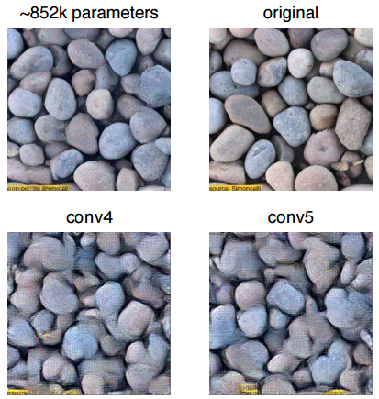
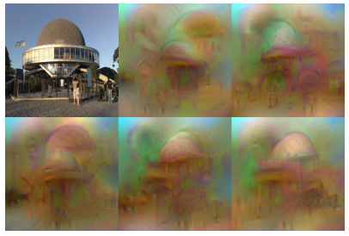
Neural Style
Texture Synthesis Using Convolutional Neural Networks
NIPS2015
Understanding Deep Image Representations by Inverting Them
CVPR2015

Slide 33
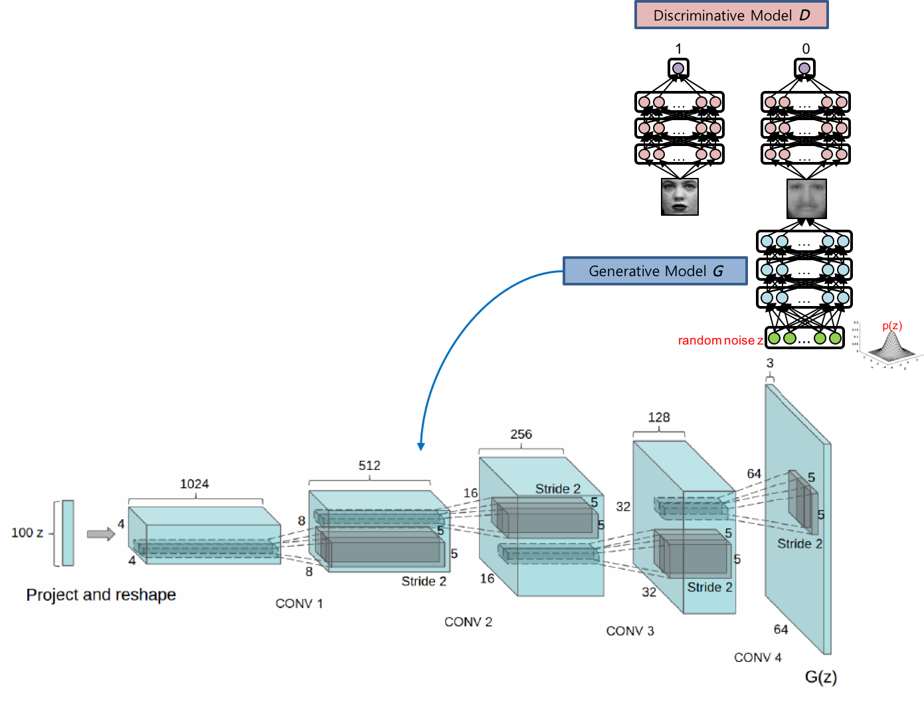
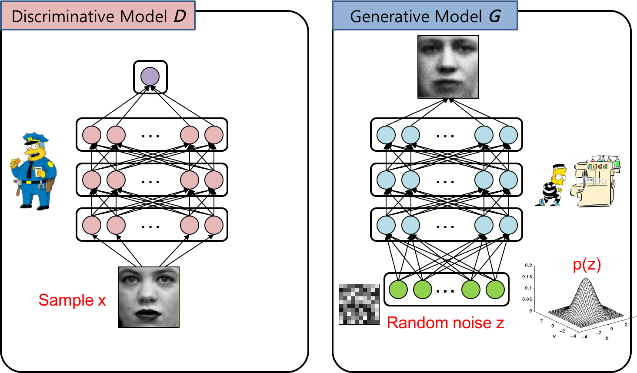
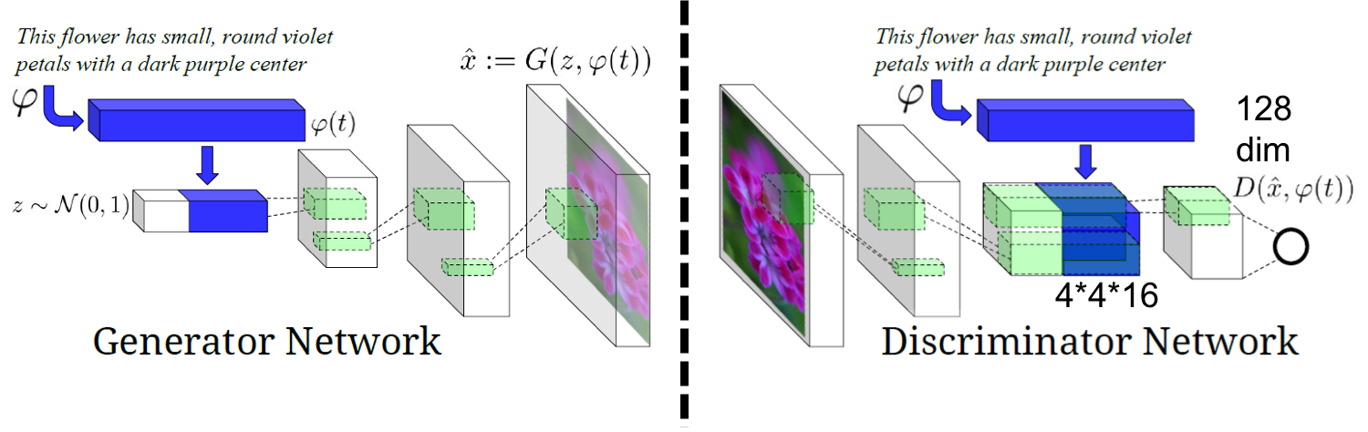
Generative adversarial networks

Slide 34
Deep learning implementations cover, (in my original course)

Slide 35
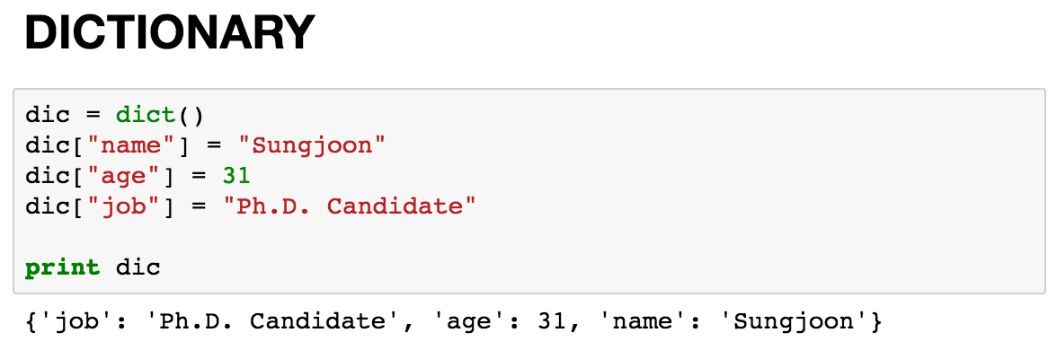
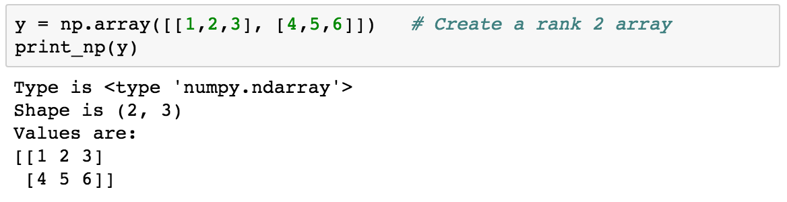
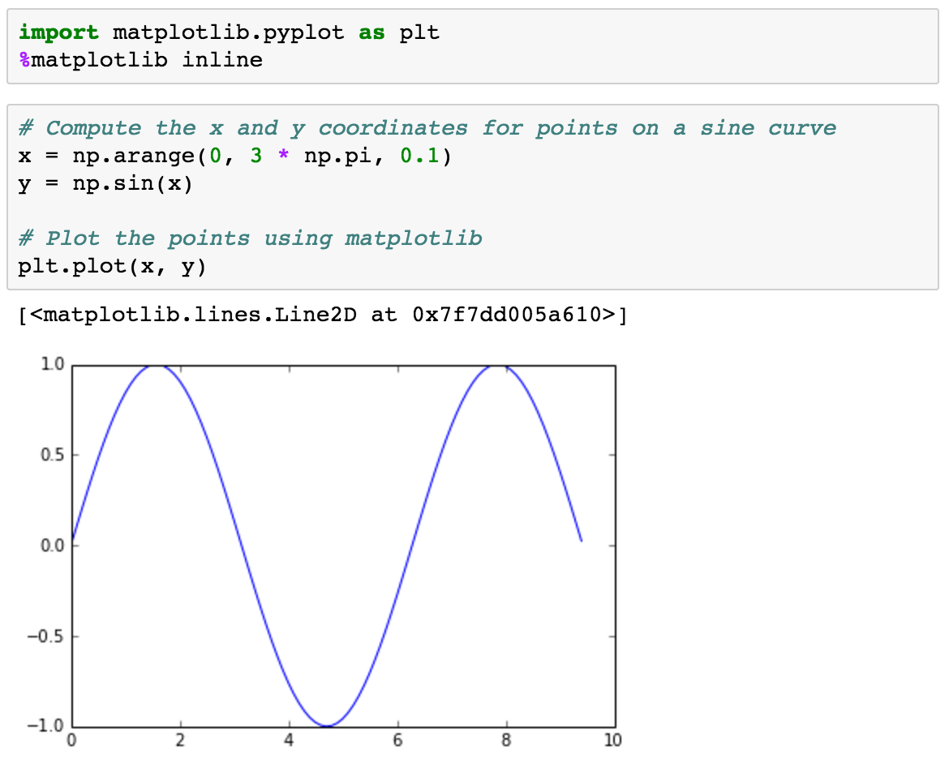
Basic Python

Slide 36
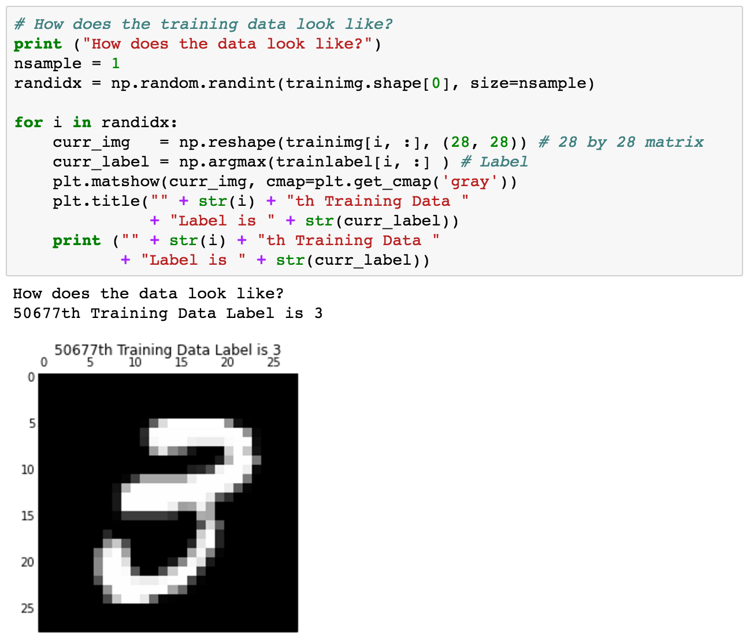
Using MNIST

Slide 37
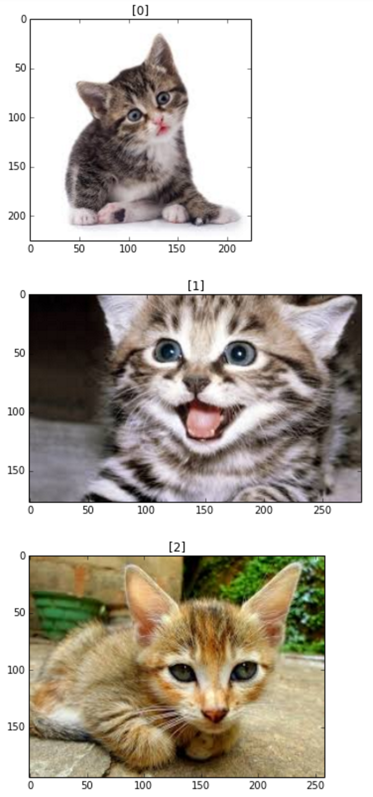
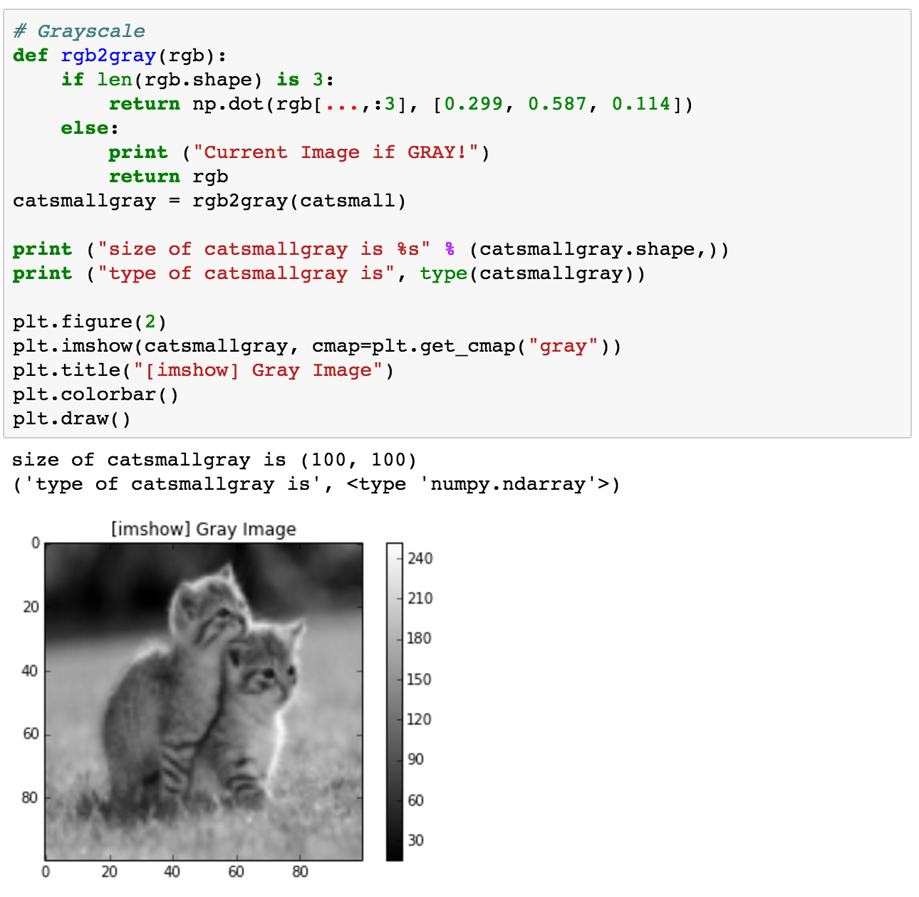
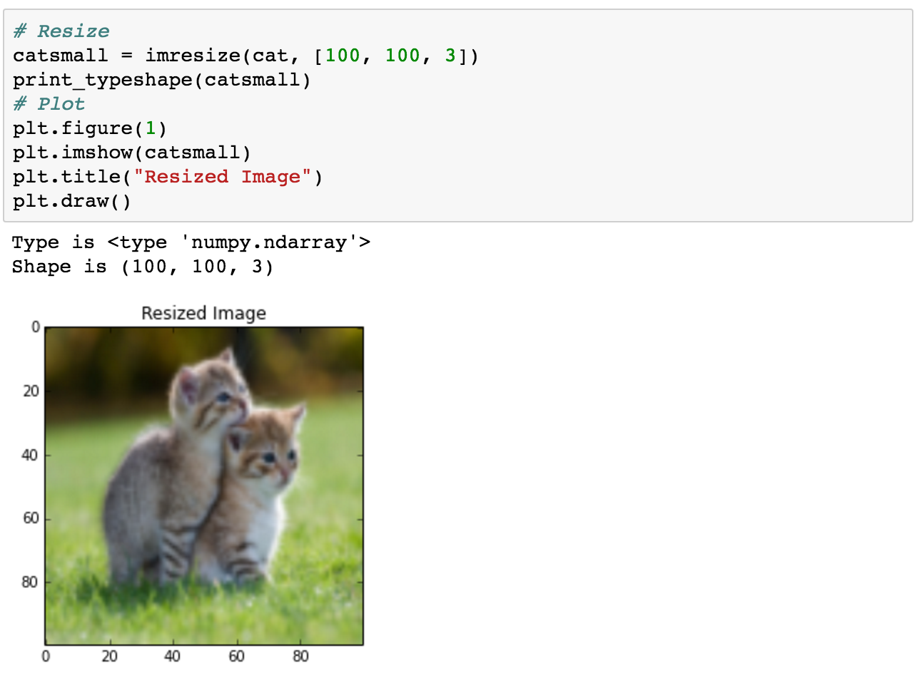
Basic image handling

Slide 38
Basic TensorFlow
Computational Graph (TensorFlow)
Optimizer
Loss
Operation
Variable
PlaceHolder

Slide 39
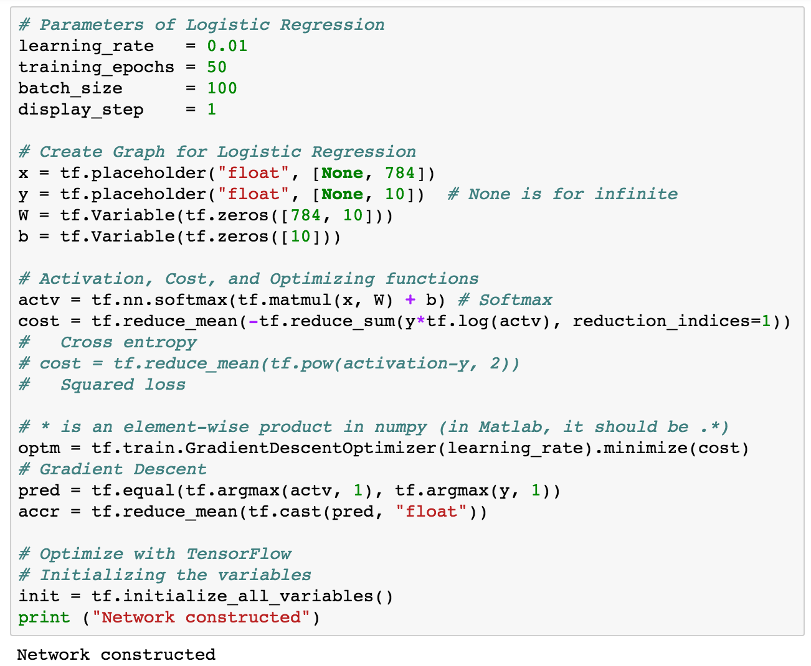
Logistic regression

Slide 40
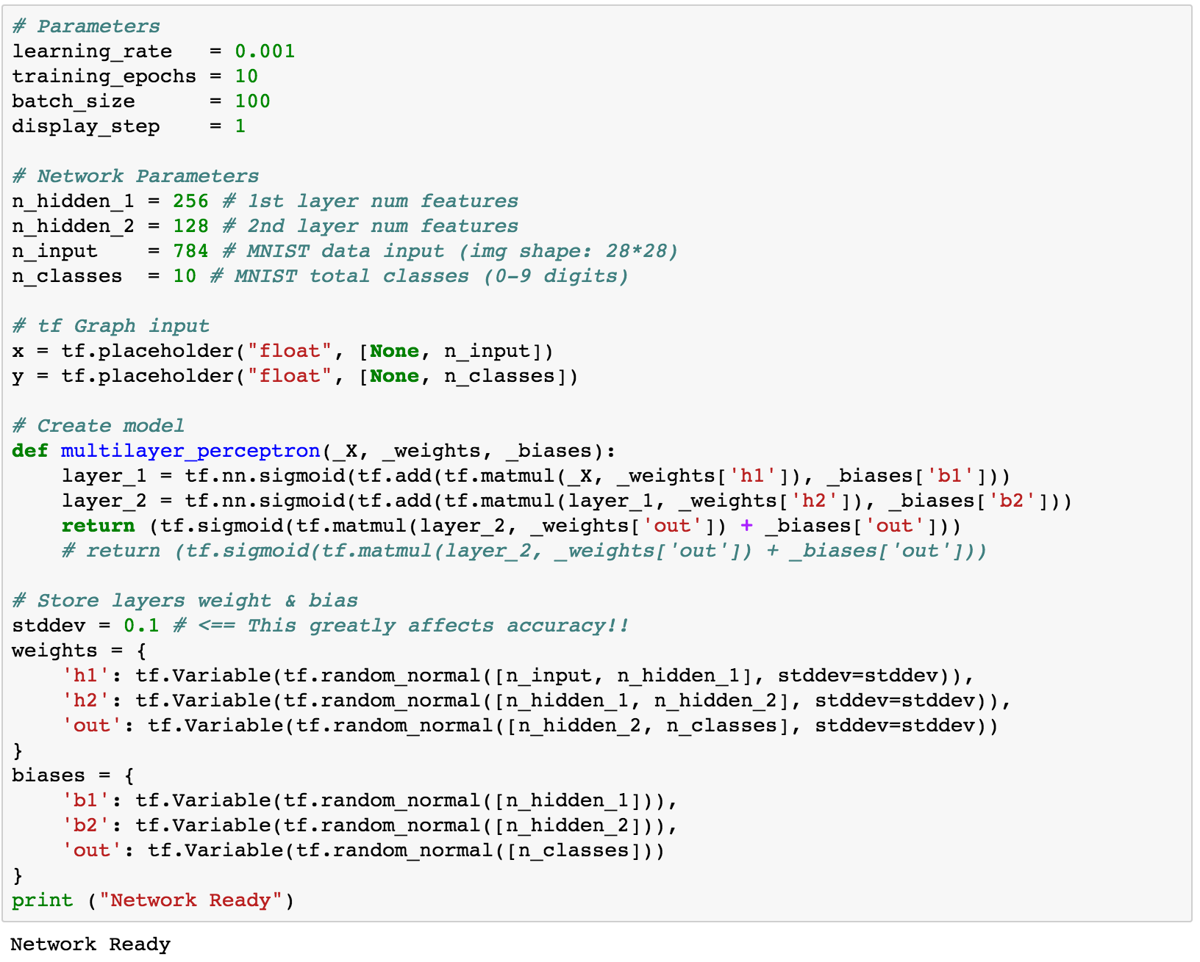
Multi-layer perceptron

Slide 41
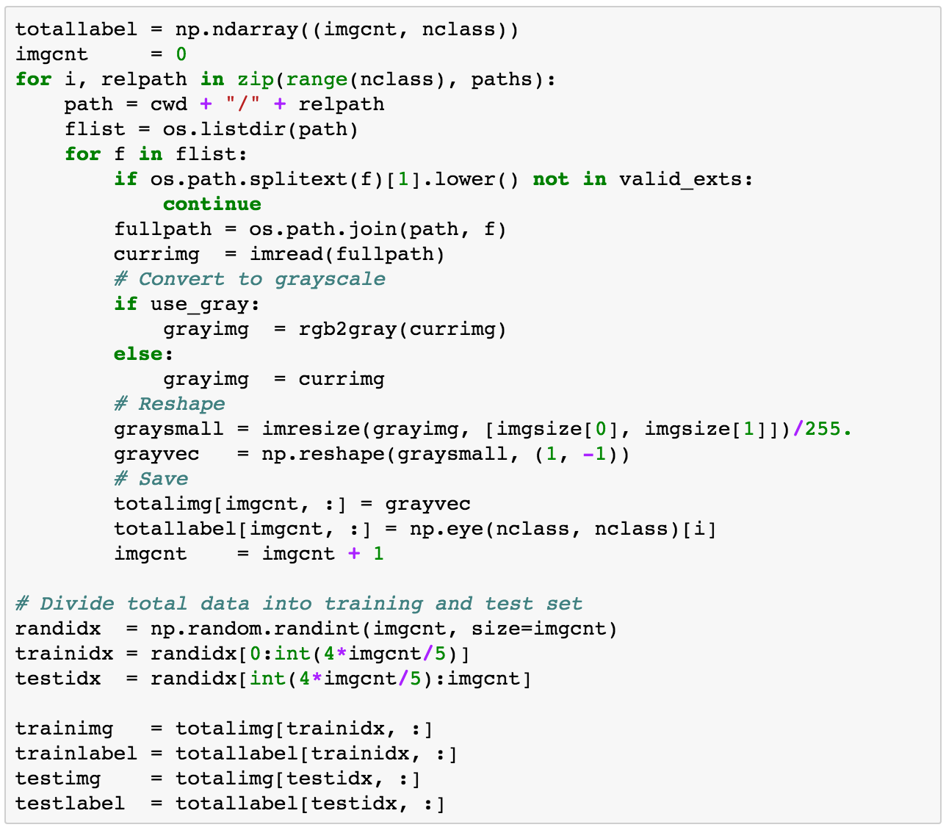
Generating own datasets

Slide 42
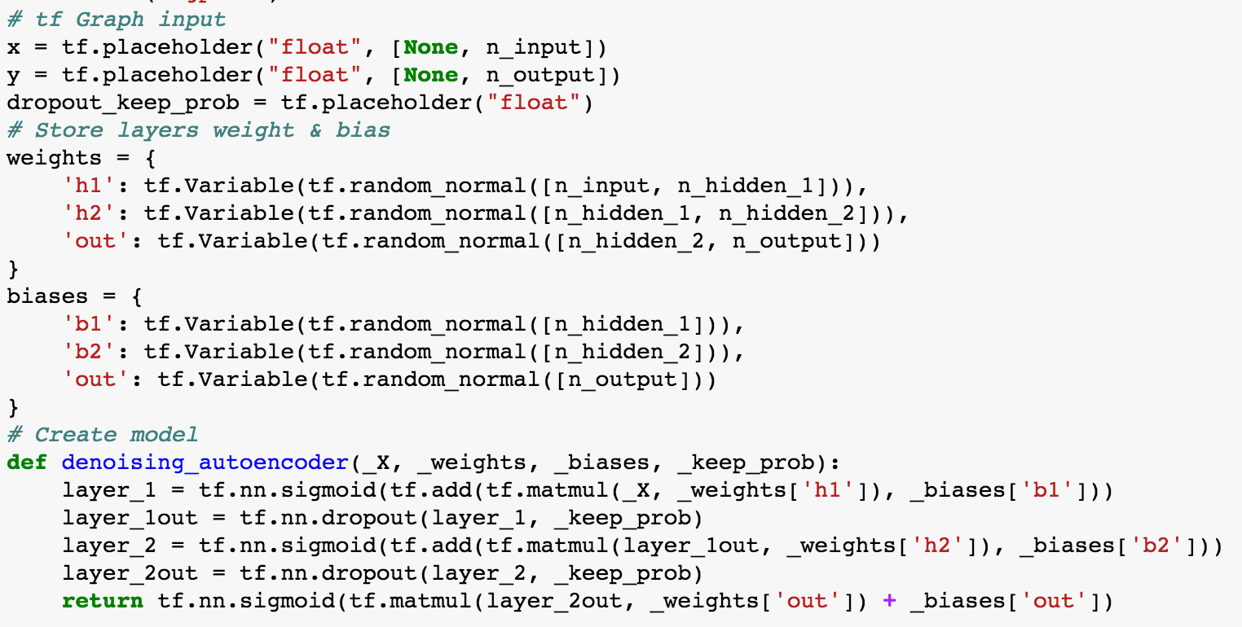
Denoising auto-encoder

Slide 43
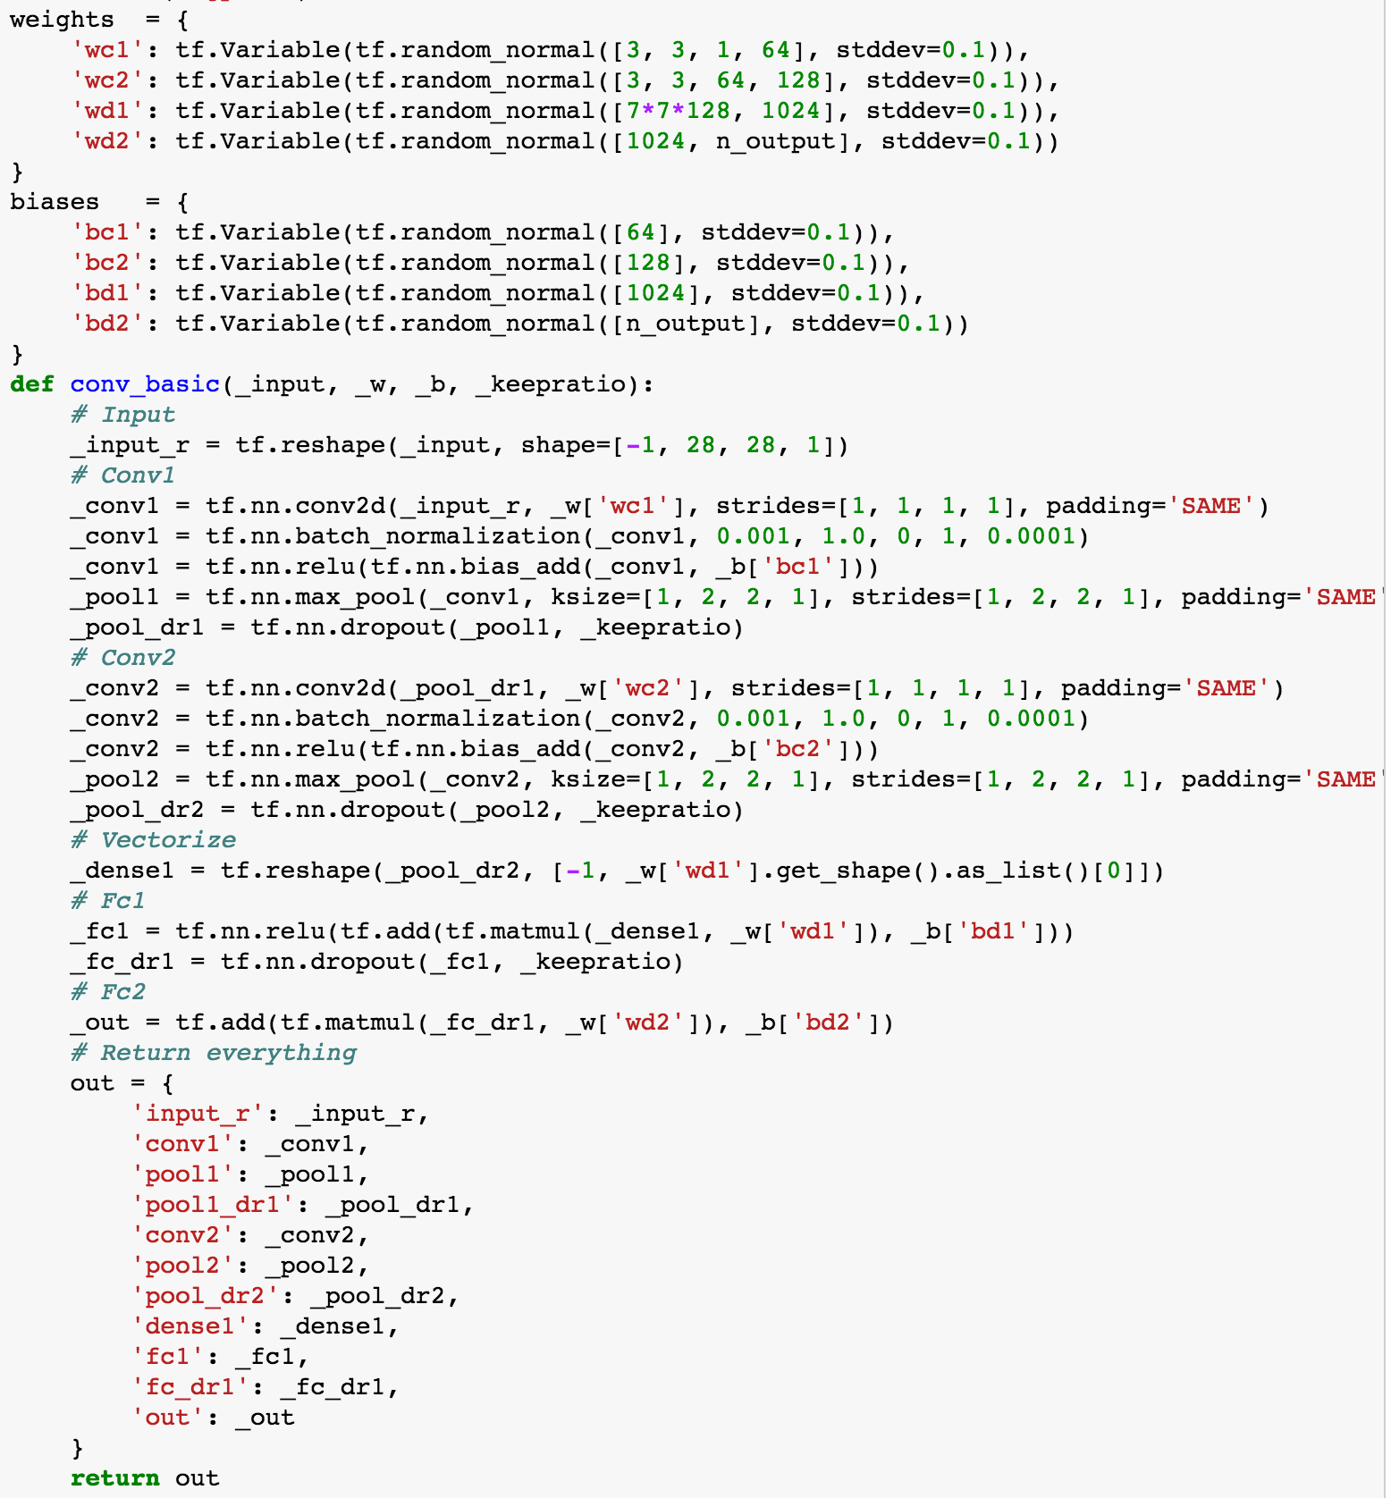
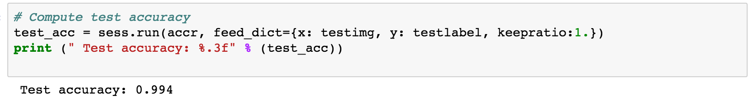
Convolutional neural network

Slide 44
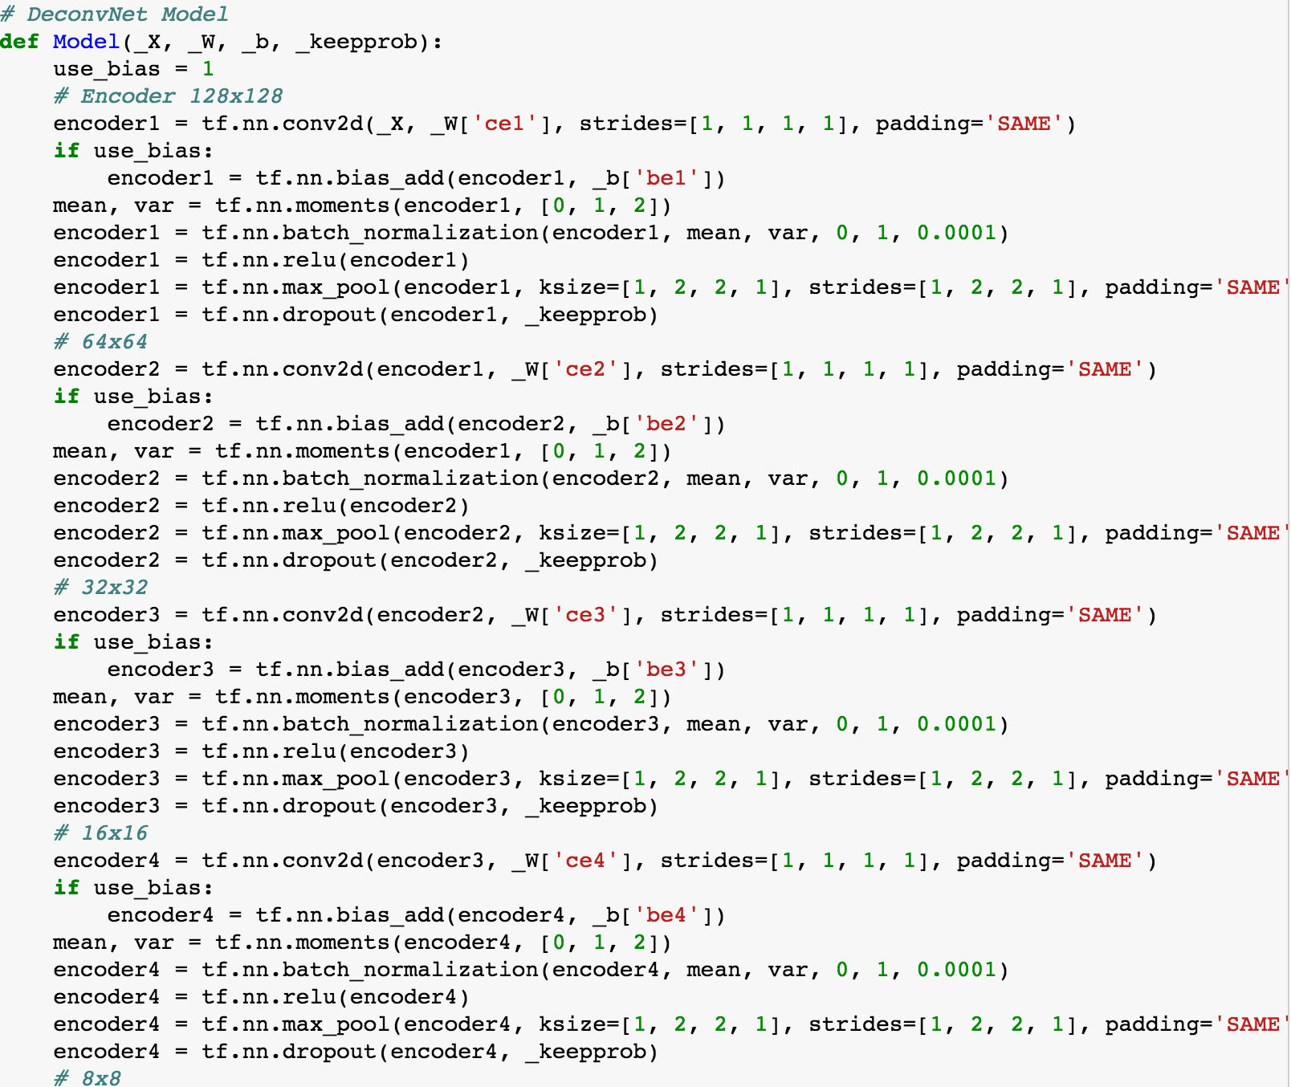

Semantic segmentation

Slide 45


TensorBoard

Slide 46

Multi-to-one RNN

Slide 47

Word2vec

Slide 48

Char-RNN

Slide 49




Neural style

Slide 50
In this workshop, we will cover,

Slide 51




Basic Python usage

Slide 52




Image Handling

Slide 53





Basic TensorFlow

Slide 54





MNIST usage

Slide 55




Convolutional Neural Network

Slide 56



CNN Architectures
AlexNet
VGG
GoogLeNet
ResNet

Slide 57



Implementing Logistic Regression

Slide 58


Implementing Multi Layer Perceptron

Slide 59




Implementing CNN

Slide 60





Training with a Custom dataset
LR
LR-tuned
MLP
CNN

Slide 61




And if time permits,
Semantic Segmentation
Object Detection
Visual QnA
Generative Adversarial Network

Slide 62
Outline
Basic Python usage
Basic image handling
Basic TensorFlow usage
Basic MNIST usage
Introduction to CNNs + Famous CNN architectures
Implementing Logistic Regression
Implementing Multi Layer Perceptron (MLP)
Implementing Convolutional Neural Network (CNN)
Implementing MLP and CNN with you OWN data
Appendix1: Semantic segmentation
Appendix2: Object detection
Appendix3: Visual question and answering
Appendix4: Generative adversarial networks

Slide 63


Caution

